Slide 1
Capital Flows, Exchange-Rate Derivatives and Sterilized Interventions: Brazil as a BRIC
Márcio G. P. Garcia
Department of Economics - PUC-Rio
www.econ.puc-rio.br/mgarcia
mgarcia@econ.puc-rio.br
Seminar at the IMF Research Department
January 7th, 2010
Many of the results presented here come from Werther Vervloet’s M.Sc. Thesis. I thank Ricardo Dahis and Pedro Guinsburg, for excellent research assistance.

Slide 5
Plan of the presentation
Interest rate differentials, capital flows, exchange rate derivatives and carry-trade
Cost-benefit analysis of foreign reserves accumulation
Effectiveness of sterilized exchange-rate interventions: empirical tests
Interventions repercussions in exchange-rate derivatives markets
Controls on capital inflows
Concluding remarks

Slide 6
1. Interest Differential, Capital Flows, Exchange Rate Derivatives and Carry-Trade
The aim of this part is to estimate the importance of the carry-trade in the appreciation of the BRL.
The high interest rate differential attracts capitals through derivatives (NDFs of BRL, sale of exchange rate derivatives—USD futures—at BM&F Bovespa), and this impacts the spot exchange rate.
Despite the fact that the theory is quite clear, it is very hard to get data on carry-trade, since the majority of those financial strategies are conducted inside large internacional banks.
A good data source exists in Brazil: the BM&FBovespa.
Foreigners have tax exemption if they identifly themselves.

Slide 7
1. Interest Differential, Capital Flows, Exchange Rate Derivatives and Carry-Trade
Data show that changes in the open interest in USD futures (short position) of the nonresident (foreign) investors present strong correlation with the exchange rate.
When foreigners’ open interest rises, the USD falls (the BRL appreciates), and vice-versa. This is compatible with a shift of the funds “supply” curve over a (very short-term) stable “demand” curve.

Slide 9
Interaction Between Funds Supply and (very short-term) Stable Demand
Exchange Rate
(BRL/USD)
D
B
A
Amount of Funds (USD)

Slide 10
A → B
A → B
A → B
A → B
A → B
A → B

Slide 11
Financial Markets initially mistrust Bernanke’s ability to replace Greenspan. “Bartiromo Affair”: markets are surprised with interest rate hikes. Bad news to US economy.

Slide 13
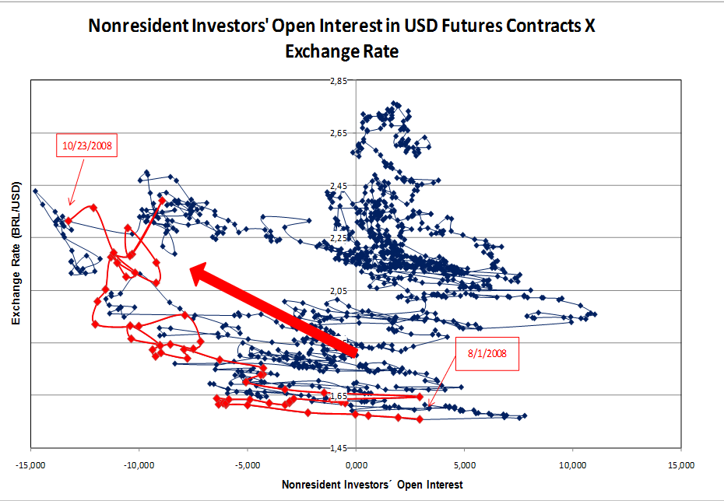
Increasing world risk aversion. Lehman’s demise precipitating world’s credit crunch, acutely affecting the Brazilian economy.

Slide 14
Interaction Between Funds Supply and (very short-term) Stable Demand
Exchange Rate
(BRL/USD)
D
A
C
Amount of Funds (USD)

Slide 15
A → C
A → C
A → C
A → C
A → C
A → C
A → C

Slide 16
Optimism with both the US and Brazilian economies.

Slide 17
This movement of appreciation, which preceded the subprime crises, is the only one that occurs with the shift of the foreigners’ open interest from short to long.

Slide 18
Bad economic indicators in the US leading to expectations that interest rates would fall.

Slide 20
1. Interest Differential, Capital Flows, Exchange Rate Derivatives and Carry-Trade
Throughout the sample period, what I called demand curve seems to be shifting downwards.

Slide 22
1. Interest Differential, Capital Flows, Exchange Rate Derivatives and Carry-Trade
Throughout the sample period, what I called demand curve seems to be shifting downwards.
Such movements are, probably, associated to larger capital inflows not related to the interest arbitrage.
Those inflows (larger exports payments or financing, FDI, portfolio inflows with longer horizon) are of lower frequency than the carry-trade, thus affecting the “demand” curve.
That is, although the interest arbitrage is one of factors causing the appreciation of the BRL, it does not seem to have had such a great influence.

Slide 23
1. Interest Differential, Capital Flows, Exchange Rate Derivatives and Carry-Trade
It remains to be done the full modeling of both “demand” and “supply” curves to explain the exchange-rate, and the role of the carry-trade.

Slide 24
2. Costs and Benefits of the Foreign Reserves Accumulation
Costs
  The reserves are invested in US Treasuries, yielding very low rates, minus the real appreciation of the BRL.
  The gross fiscal cost of the sterilization is the real rate of interest (now around 4.5% for the public domestic debt).
  Therefore, if the real exchange rate remains constant (requiring a depreciation of the BRL around 2% a year), there is a financial cost of around 4% per year. The actual numbers for previous years have been much higher, because the domestic real interest rate was higher and the BRL appreciated.
Benefits
  Fall in the risk premiuns, reducing the interest rates and stimulating capital inflows, thus reducing the cost of capital for Brazilian firms. This channel, however, is almost exhausted.
  Fall of the exchange rate volatility, which reduces the volatility of real interest rate and economic activity.
  Insurance against trade or, most importantly, capital flows shocks (reduced external vulnerability).

Slide 25
2. Costs and Benefits of the Foreign Reserves Accumulation
Reserves higher than USD 240 billions exceed, by far, the great majority of indexes proposed as desirable amounts of reserves. (Guidotti-Greenspan rule, n months of imports and others);
Studies using cost-benefit analysis for Brazil (Salomão, 2007) indicate that this was already the case before the sub-prime crisis;
However, above anything, the crisis taught policy-makers that countries needed more reserves than our models predicted.
But how much?
Jeanne and Rancière (2009) built a model and estimate around 9% the optimal level of reserves for insurance purposes. At the time of their writing, only Asia had gone beyond the full-insurance level of 16.5%. Brazil current foreign reserves is almost reaching 16% of GDP, and will soon also constitute a puzzle in their terminology, as many Asian countries that are suspected to manipulate their currencies.

Slide 26
2.1. Costs and Benefits of the Exchange Reserves Accumulation: Fiscal Dominance
It is generally argued that, under the inflation targeting framework, the interest rate (Selic) must be set without considering its impact on the fiscal budget. The costs of higher interest rates on the public debt (fiscal dominance) should not be considered, since this could cause loss of efficiency and credibility of the monetary policy. The current case, however, is different from the traditional case of fiscal dominance. Nowadays, the same Central Bank that sets the interest intervenes in the exchange market.
If the Central Bank didn’t intervene, the exchange rate would be even more appreciated, causing a bigger fall on inflation, making possible a larger reduction of interest rates.
To intervene in the exchange markets and not consider the costs associated to keeping the higher interest rate does not seem to be reasonable.
Notes:
26

Slide 27
2.2. Costs of the Exchange Reserves Accumulation: Worsening of Debt Structure

Slide 28
2.2. Costs of the Exchange Reserves Accumulation: Worsening of Debt Structure

Slide 29
2.2. Costs of the Exchange Reserves Accumulation: Higher Implicit Interest Rates on the Public Debt

Slide 30
2. Costs and Benefits of the Exchange Reserves Accumulation
The cost of each additional 1 USD of reserves is the interest differential, which is not small and is expected to rise, since the Brazilian CB signaled that it is already waiting to raise the Selic interest rate, while the benefit of each 1 additional USD has been significantly falling.
Reserves reduce the risk of external shocks (sudden stops) but their cost increases the fiscal risk. There will certainly be a (finite) level, from which the net benefit of additional reserves accumulation will be negative.
Brazil did very well during the crisis with less reserves than it has now.
If less than today’s reserves was enough to weather the perfect storm of September 2008, does it now need more reserves than before?

Slide 31
2. Costs and Benefits of the Exchange Reserves Accumulation
Thus, today, if someone thinks that USD 240billion reserves are not too much, but is willing to model what the desirable amount is, it is certain that, at the current rhythm of interventions (USD 30billion during the second half of 2008), soon enough she/he will change her/his mind.
Such reasoning drives the market to suspect, despite many CB’s denials, that the purpose of the exchange rate interventions is not only to reduce external economic vulnerability, nor to “smooth” the trajectory of the exchange rate, but also to influence the level of the nominal exchange rate.
Even if such suspicion is found wanting, it is reasonable to assume that it would be considered a bonus if sterilized purchases of foreign reserves were to depreciate the nominal exchange rate.
Therefore, let’s turn to the empirical issue of whether of not sterilized interventions have been affecting the nominal exchange rate in Brazil.

Slide 32
3. Effectiveness of the Sterilized Interventions: Empirical Tests
Controlling for the determinants of the exchange rate flow, and for the changes in the foreign debt, interventions have a small effect, although statistically significant, on the nominal exchange rate.
The purchase of USD 1 billion depreciates the exchange rate between 0,54% and 1,56%, that is, to go from 1,7300 BRL/USD to between 1,7393 BRL/USD and 1,7570 BRL$/USD.

Slide 33
∆St | OLS(1) | OLS(2) | 2SLS(1) | 2SLS(2)
c | -0,0382* | -0,044** | -0,104*** | -0,110***
 | (-1,864) | (-2,226) | (-3,473) | (-2,947)
∆(i-i*)t | 0,191 | 0,174 | 0,311 | 0,321
 | (0,332) | (0,274) | (0,518) | (0,513)
∆(Ibov)t | -0,117*** | -0,117*** | -0,124*** | -0,124***
 | (-3,648) | (-3,925) | (-3,713) | (-3,756)
∆(CRB)t | -0,173*** | -0,173*** | -0,183*** | -0,184***
 | (-6,153) | (-6,216) | (-6,238) | (-6,198)
∆(Embi-BR)t | 0,091*** | 0,092*** | 0,088*** | 0,088***
 | (3,576) | (3,918) | (3,484) | (3,455)
(Open Interest)t | 0,017** | 0,016** | 0,037*** | 0,038***
 | (2,518) | (2,182) | (4,093) | (4,038)
(Inflation Surprise)t | -3,946** | -3,931** | -4,330** | -4,360**
 | (-2,396485) | (-2,407) | (-2,480) | (-2,458)
(Interv. Tot.)t | 0,099* | - | 0,543*** | -
 | (1,925) | - | (3,341) | -
(Interv. +)t | - | 0,121** | - | 0,584***
 | - | (2,535) | - | (3,442)
(Interv. -)t | - | 0,044 | - | 0,577*
 | - | (0,261) | - | (1,817)
AR(1) | -0,179** | -0,179** | -0,174** | -0,172**
 | (-2,153) | (-2,178) | (-2,170) | (-2,206)
F Stat. | 81,64*** | 72,58*** | 79,51*** | 70,35***
Adj. R2 | 0,334 | 0,334 | 0,304 | 0,295
Q Stat. (6 lags) | 5,36 | 5,27 | 6,49 | 6

Slide 34
∆St | MQO(1) | MQO2e(1)
c | -0,020 | -0,088**
 | (-0,868) | (-2,330)
∆(i-i*)t | 0,199 | 0,692
 | (0,323) | (0,888)
∆(Ibov)t | -0,116*** | -0,116***
 | (-3,515) | (-3,692)
∆(CRB)t | -0,173*** | -0,188***
 | (-6,119) | (-5,585)
∆(Embi-BR)t | 0,091*** | 0,088***
 | (3,563) | (3,772)
(Open Interest)t | 0,012* | 0,044***
 | (1,771) | (4,120)
(Inflation Surprises)t | -3,814** | -4,258**
 | (-2,341) | (-2,423)
AVt | -0,147 | -0,025
 | (-1,515) | (-0,112)
(Fut. +)t | 0,238*** | 1,56***
 | (3,54) | (2,847)
(Fut. -)t | 0,099 | 1,49*
 | (0,411) | (1,826)
AR(1) | -0,182** | -0,173**
 | (-2,201) | (-2,540)
F Stat. | 66,22*** | 53,83***
Adj. R2 | 0,337 | 0,143
Q Stat. (6 lags) | 4,84 | 6,7

Slide 35
4. Repercussions of the Sterilized Interventions in Exchange-Rate Markets
Let us examine the mechanics of a sterilized spot dollar purchase by the Central Bank:
When the Brazilian Central Bank (BCB) buys USDs, it injects BRLs which are sterilized through the sale of treasury bonds previously held by the BCB;
This purchase of dollars increases the spot dollar, decreasing the forward premium;
As the domestic short-term interest rate did not change, the onshore dollar rate (cupom cambial) increases;
With the onshore dollar rate increase, banks borrow more dollars abroad to invest them in Brazil at the higher onshore dollar rate. To do so, they sell the borrowed USD in the spot market, invest the acquired BRL in treasury bonds, and purchase USD futures to guarantee a USD return equal to the onshore dollar rate;
The final result of the BCB’s intervention is the attraction of more USD, which weakens the effect of the intervention over the exchange rate.

Slide 36
Covered Interest Parity (CIP)
f – s = i – i*
f
f
Forward
Premium
i
s1
s0
i*
Cupom
Cambial

Slide 37
Spread between the onshore and offshore dollar rates and banks' short term arbitrage (3 months)
BRL/USD

Slide 38
Spread between the onshore and offshore dollar rates and banks' short term arbitrage (3 months)
BRL/USD

Slide 39
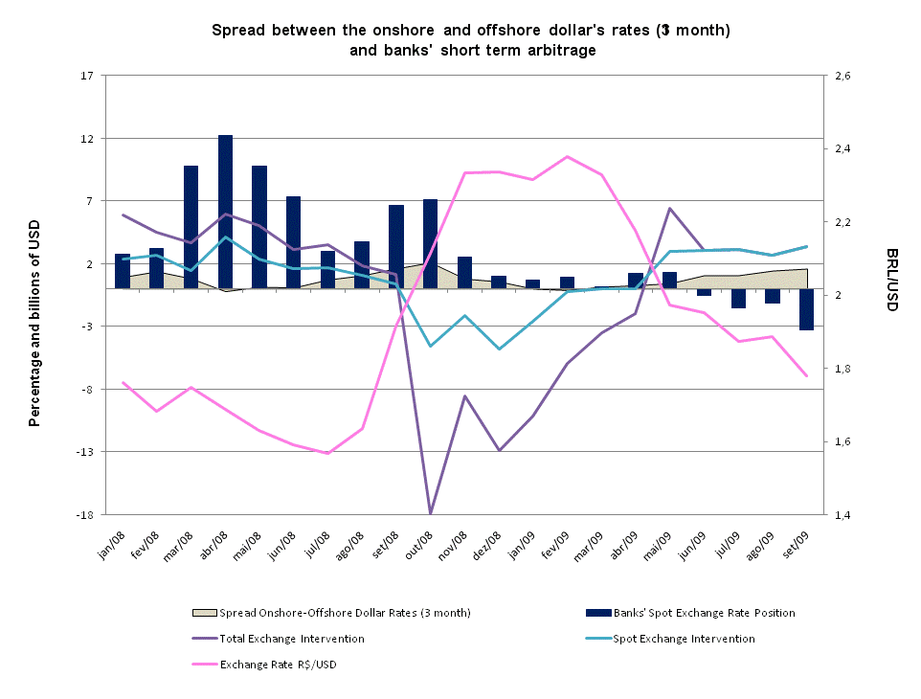

Slide 40
4.1. Sterilized Interventions Effect on the Onshore-Offshore Spread
DCC1Mt | OLS
c | 0,021
 | (1,153)
(Spot +)t | 0,214***
 | (3,158)
(Spot –)t | 0,873**
 | (2,266)
(Fut. +)t | 0,050
 | (1,159)
(Fut. -)t | 0,159
 | (1,379)
DCC1Mt-1 | 0,826***
 | (43,578)
F - Stat. | 603,17***
Adj. R2 | 0,701
Q Stat. (7 lags) | 73,78***
DCC3Mt | OLS
c | 0,002
 | (0,38)
(Spot +)t | 0,058*
 | (1,734)
(Spot –)t | -0,265
 | (-0,935)
(Fut. +)t | 0,001
 | (0,069)
(Fut. -)t | (0,073)
 | (1,031)
DCC3Mt-1 | 0,939***
 | (66,65)
F - Stat. | 2250***
Adj. R2 | 0,89
Q Stat. (7 lags) | 13,68*

Slide 41
4.2. Spread Onshore-Offshore and Banks´Short Term Arbitrage
BPt | OLS |  | BPt | OLS
c | 4102,5*** |  | c | 3880,3***
 | (4,03) |  |  | (3,71)
(Spot +)t | -1149,4*** |  | (Spot +)t | -1179,1***
 | (-4,35) |  |  | (-4,18)
(Spot –)t | 1162,7*** |  | (Spot –)t | 914,7
 | (2,44) |  |  | (1,43)
(Fut. +)t | 0,307 |  | (Fut. +)t | -0,165
 | (0,90) |  |  | (-0,56)
(Fut. -)t | -0,047 |  | (Fut. -)t | 0,575
 | (-0,167) |  |  | (1,306)
DCC1Mt | -1375,5*** |  | DCC3Mt | -1342,19*
 | (-3,09) |  |  | (-1,69)
Dummy | -4619,4*** |  | Dummy | -4270,3***
 | (-3,87) |  |  | (-3,34)
F - Stat. | 12,32*** |  | F - Stat. | 9,84***
Adj. R2 | 0,32 |  | Adj. R2 | 0,26

Slide 42
4.3. Repercussions of the Sterilized Interventions in Exchange-Rate Markets
Theoretically, there are two channels through which sterilized interventions could be effective: signaling and portfolio balance channel.
Signaling is not relevant under Inflation Targeting.
The portfolio balance channel depends upon domestic and foreign bonds being imperfect substitutes.
With the onshore-offshore-dollar-rate arbitrage, it is likely that domestic and foreign bonds become perfect substitutes. Therefore, sterilized interventions should have little, if any, effect on the nominal exchange rate.

Slide 43
4.4. Does it matter the market in which the CB intervenes: spot or futures?
According to the typical models used in modern finance, sterilized interventions should not affect the nominal exchange rate, unless those affected fundamentals.
Those models help even less to answer the question of where to intervene, since futures and spot prices are always perfectly arbitraged.
Size and liquidity considerations have not yet been successfully incorporated in finance, to the point of building new “workhorses” models.
With these caveats in mind, let me speculate about possible distinctions between the spot and futures (sterilized) interventions by the CB.
Spot sterilized purchases increase the onshore dollar rate (cupom cambial), thereby enticing banks to borrow abroad and invest (in USD) onshore. What happens when the CB purchases USD futures (or swaps)?

Slide 44
4.4. Does it matter the market in which the CB intervenes: spot or futures?
Let’s analyze the purchase of USD futures (swap reverso) by the CB:
When the CB buys USD futures, the futures exchange rate increases incipiently, and so does the forward premium;
Given that the domestic interest rate does not change, the onshore dollar rate (cupom cambial) is reduced;
Banks arbitrage the difference between the onshore and offshore dollar rates by borrowing onshore (in USD) and lending offshore. For that they borrow in BRL onshore, buy the USD in the spot market, lend abroad (at the Libor) and purchase USD futures to cover the exchange-rate risk and lock in the differential between the Libor and the cupom cambial.
Thererefore, when the CB intervenes through purchases of USD futures (swap reversos), it initiates a process that make private banks buy USD in the spot market (instead of selling, as in the case of spot market sterilized interventions).
Does this matter? The previous empirical result hints that it might.
However, other factors may be playing a role, as liquidity (the Brazilian USD futures market is much larger and more liquid than the spot market; a jabuticaba).
The CB may face a problem to intervene through the swap market, since financial losses in derivatives markets may be more difficult to explain than mark-to-market losses of the stock of “greenbacks”.
If this is indeed a problem, the swap contracts could be adapted to deliver the spot USD when the contracts mature (deliverable swaps).

Slide 45
4.5. Post hoc ergo propter hoc?
It has been argued that, for the mechanism we just described to be true, it is necessary that interventions come before the onshore dollar rate increase, but statistical tests (Granger causality) would prove the opposite.
Let’s see, then, an alternative sequence of events, which is compatible with the economic causality of the interventions on the onshore dollar rate, as well as with the Granger causality in opposite direction.

Slide 46
4.3. Post hoc ergo propter hoc?
Let us examine the alternative mechanics:
Speculators sell USD futures contracts at BM&F to pocket the interest rate differential;
The USD futures contracts sale reduces the USD futures price, decreasing the forward premium;
As the domestic interest rate has not been changed, the onshore dollar interest rate (cupom cambial) increases, opening a positive spread vis-à-vis the USD rate in foreign markets (Libor);
The positive spread between onshore and offshore dollar rates attracts banks, that borrow USD abroad to invest them in Brazil at the higher onshore dollar rate;
If the Central Bank did not intervene purchasing dollars, the spot USD rate, pressured by the banks selling flow, would tend to decrease, in line with the previous movement of the dollar futures, restoring equilibrium with more appreciated spot and futures exchange rates;
However, as the Central Bank intervenes in the spot market, the spot USD rate does not fall (the BRL does not appreciate), neither does the wedge between the onshore and the offshore dollar rates, keeping the banks’ arbitrage opportunity open as long as the Central Bank keeps intervening;
The final result of the Central Bank’s intervention is the attraction of more USD, which weakens the effect of the sterilized intervention on the exchange rate.

Slide 47
5. Controls on Capital Inflows
On October 20, 2009, Brazil started charging a 2% tax on exchange rate transactions aimed at purchasing Brazilian bonds or stocks. Such tax has already been imposed in the past, but never including the stock market. Later on, this measure was complemented by a 1,5% IOF tax on Depositary Receipts.
In a previous paper (Carvalho and Garcia, 2005), we show that capital inflows (ex-ante) controls had limited effectiveness in deterring financial inflow.
Analyzing 11 actual cases of capital controls circunventions, we show that the change in the composition of capital inflows might be deceiving, since the circumvention operations tend to disguise short term capital as long term one to avoid the tax.
To suppose that the mere imposition of capital controls is the same as their effective implementation is wrong and might lead economic policy to costly mistakes.
Capital controls can, in the best cases, be effective for brief periods while structural reforms are being implemented. They cannot keep foreign capital at bay when carry-trade-type-arbitrage operations are highly profitable (i.e., domestic interest rate is high), or, as today, the economic prospects are excellent and foreign investors want to invest in Brazil.

Slide 48
6. Conclusion
If the world keeps recovering from the crisis, Brazil will continue to do well and be one of the favorite destinations to foreign capital.
These capital inflows will put pressure to further appreciate the BRL. The exchange rate appreciation will, in turn, press policy makers to do “something”, as the 2% tax, especially now that a large part of the media complimented Brazil for its initiative (FT, The Economist, and even the father of Washington consensus).
Currently, the government is contemplating opening up the still closed Brazilian exchange rate markets. This is very good for Brazil in the long run, but it is not clear that it will help to depreciate the BRL.
Sterilized interventions will continue, albeit their high fiscal costs and small effects on the exchange rate, and reserve accumulation will proceed.
Policy slippages, as the de facto abandonment of Inflation Targeting for the sake of exchange rate control, is a risk.
Fiscal policy measures that could help to depreciate the real real exchange rate are out until a new government arrives in 2011.

Slide 49
Thanks
Obrigado
Gracias
Merci
Danke
Grazzie

